Slide 1
Data Binding and Validations
Day 2 - Chapter 1

Slide 2
Sample Application Examples
Login-Logout
Search Flight
Book Flight
Cancel Flight
User Registration
Install sample application and start recording
http://127.0.0.1:1080/WebTours/index.htm

Slide 3
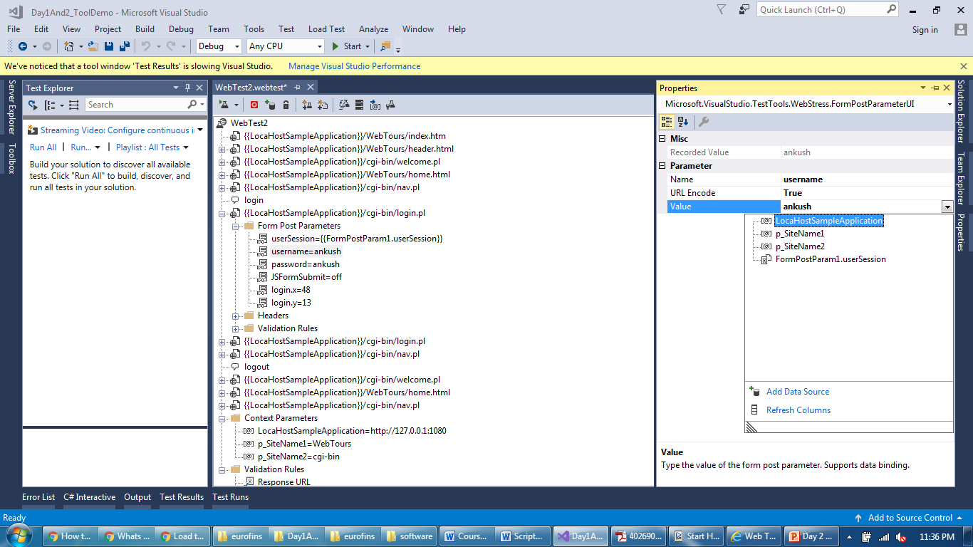
Data Binding
Place to bind Data (replace actual value with parameter)

Slide 4
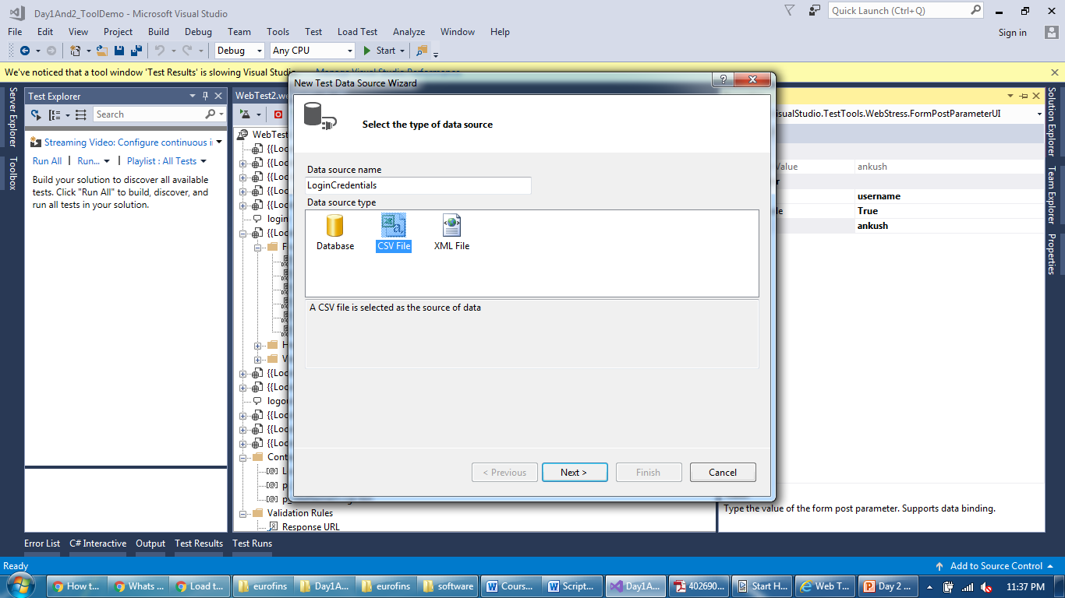
Data Binding
Three types of Data Sources

Slide 5
Data Binding
Three types of Data Sources

Slide 6
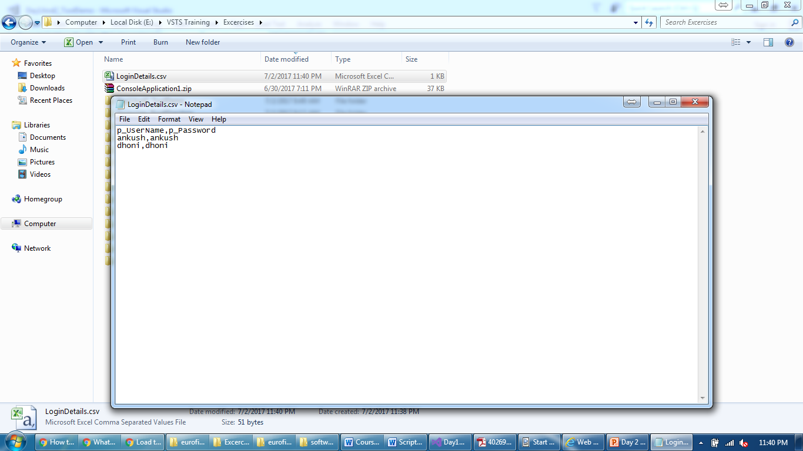
Data Binding
Create a “Comma Separated Value” file

Slide 7
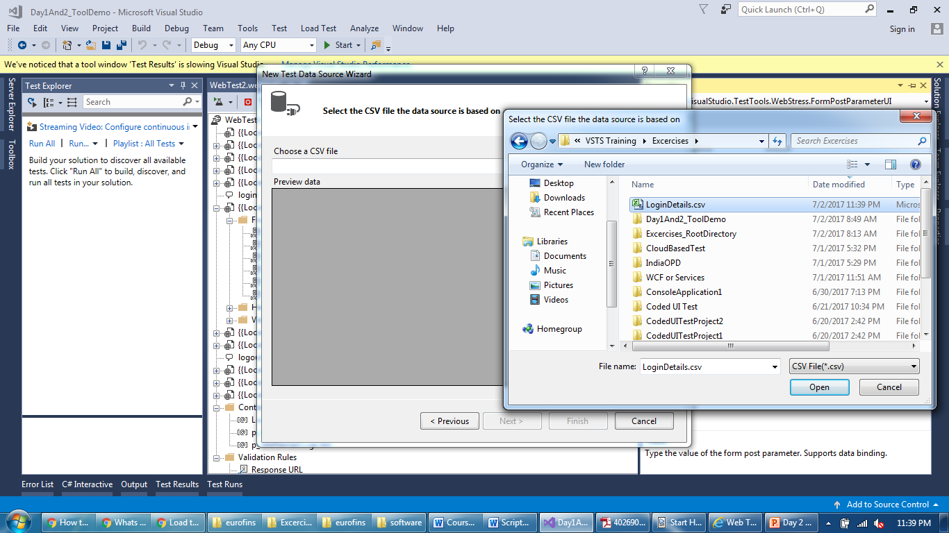
Data Binding
Point a data source to a CSV file

Slide 8
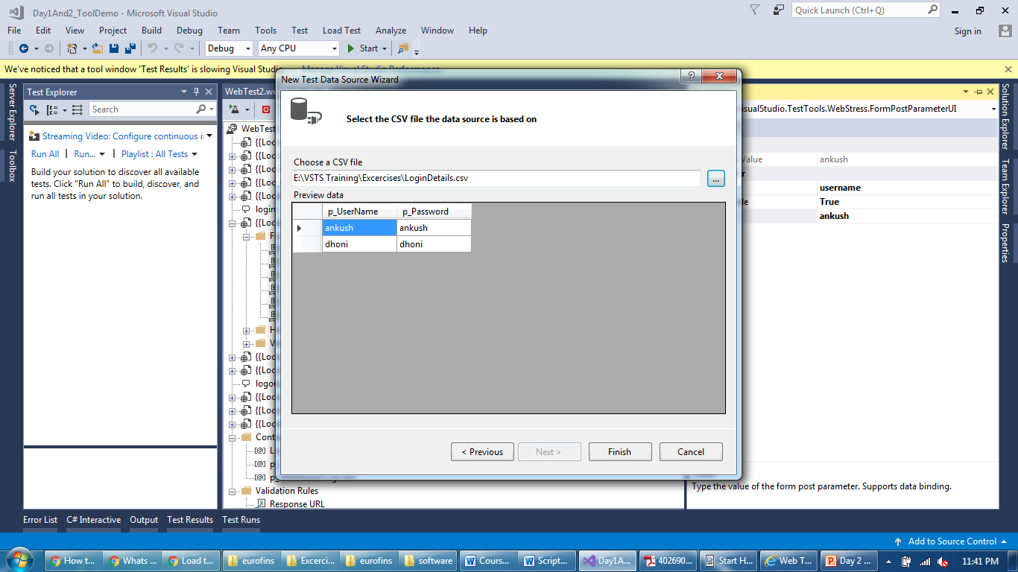
Data Binding
If everything correct, value will be printed

Slide 9
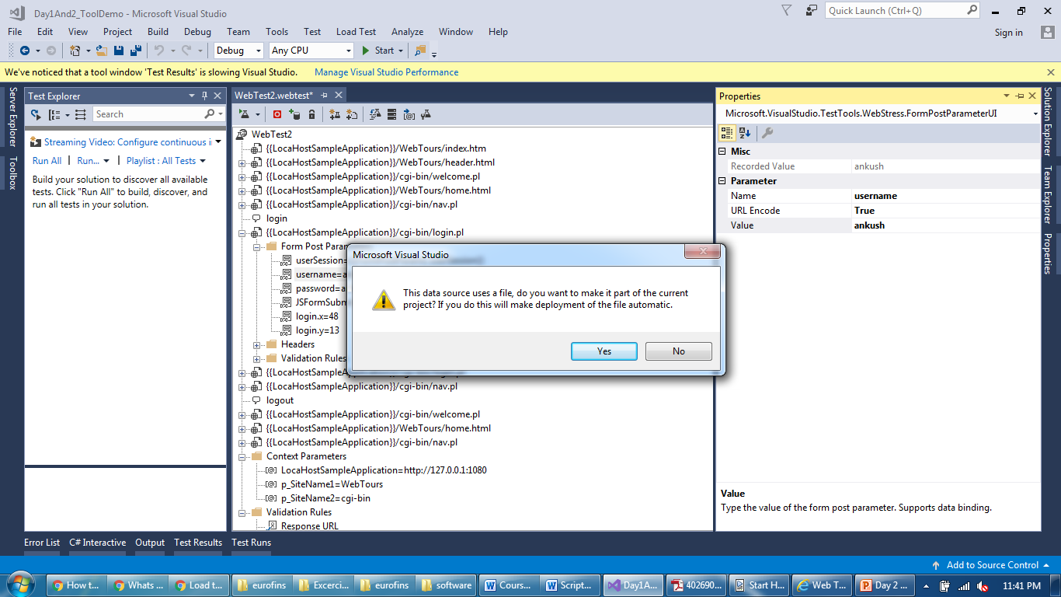
Data Binding
Keep a CSV file inside a script at a folder level on a disk

Slide 10
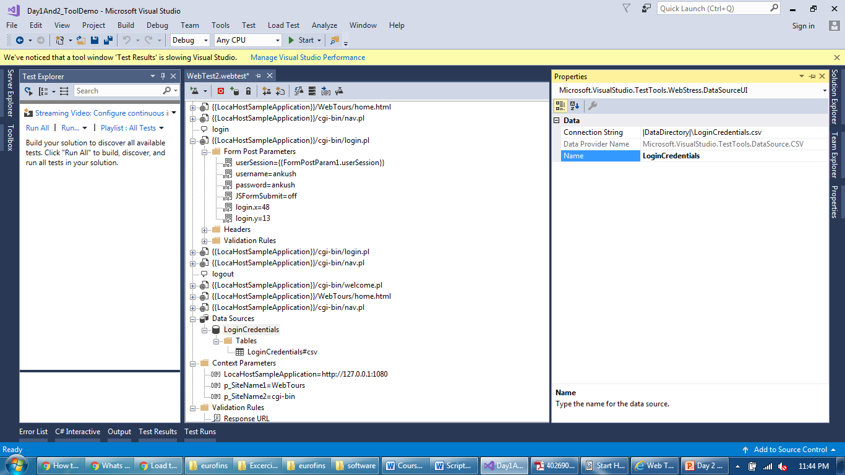
Data Binding
Data source added and it’s properties visible

Slide 11

Data Binding
Table level properties of a added CSV file

Slide 12
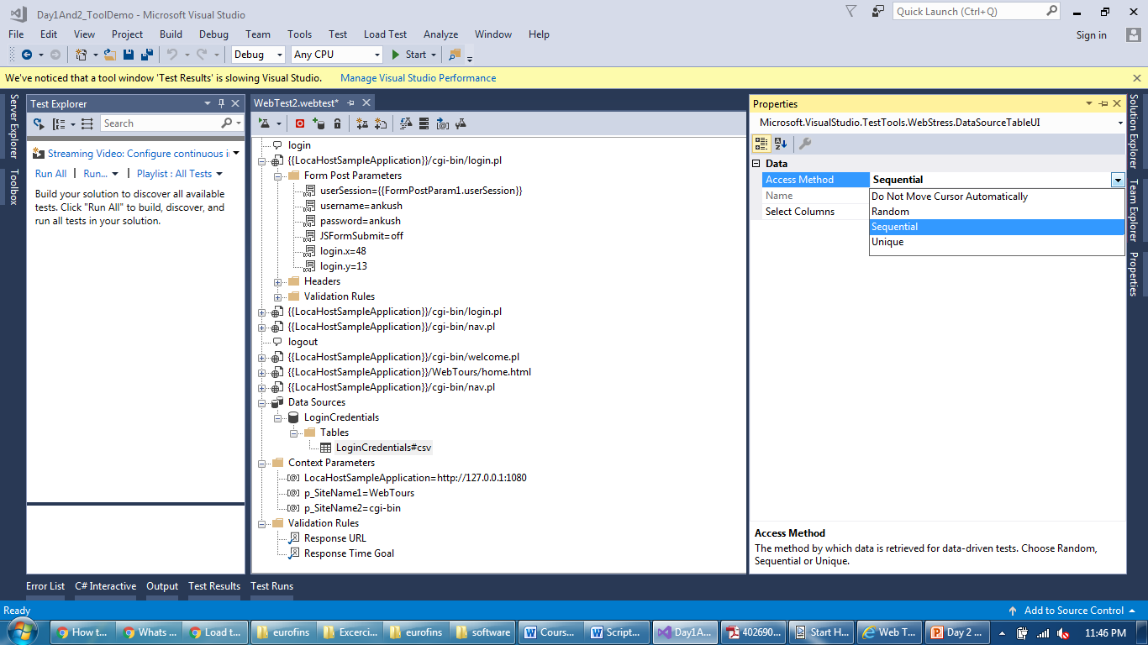
Data Binding
Use it carefully as per data need (reusable data or once use)

Slide 13
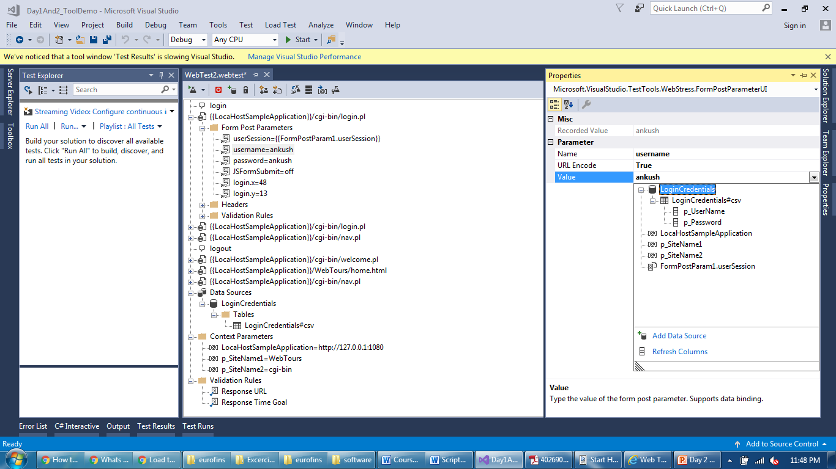
Data Binding
To bind data, select drop down near data and select param

Slide 14
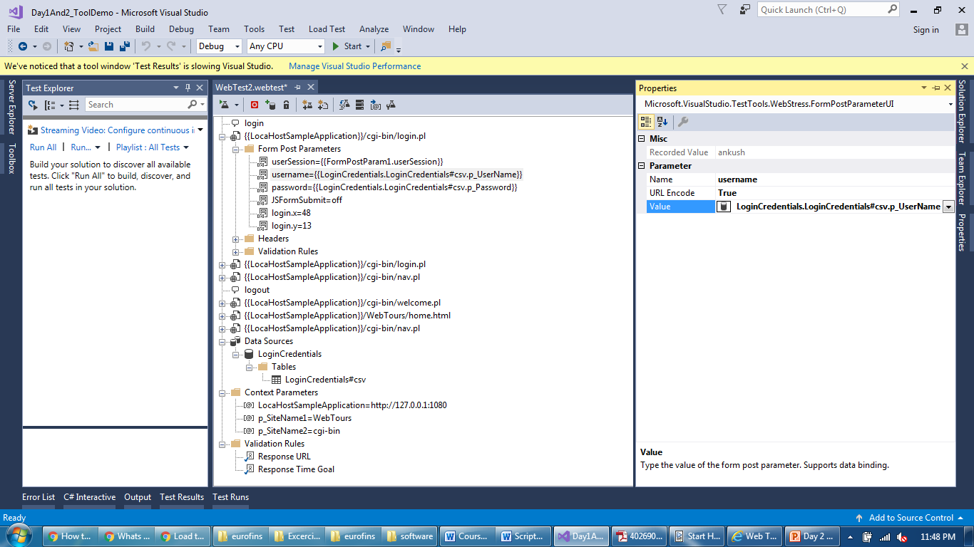
Data Binding
Value is replaced by the parameter

Slide 15
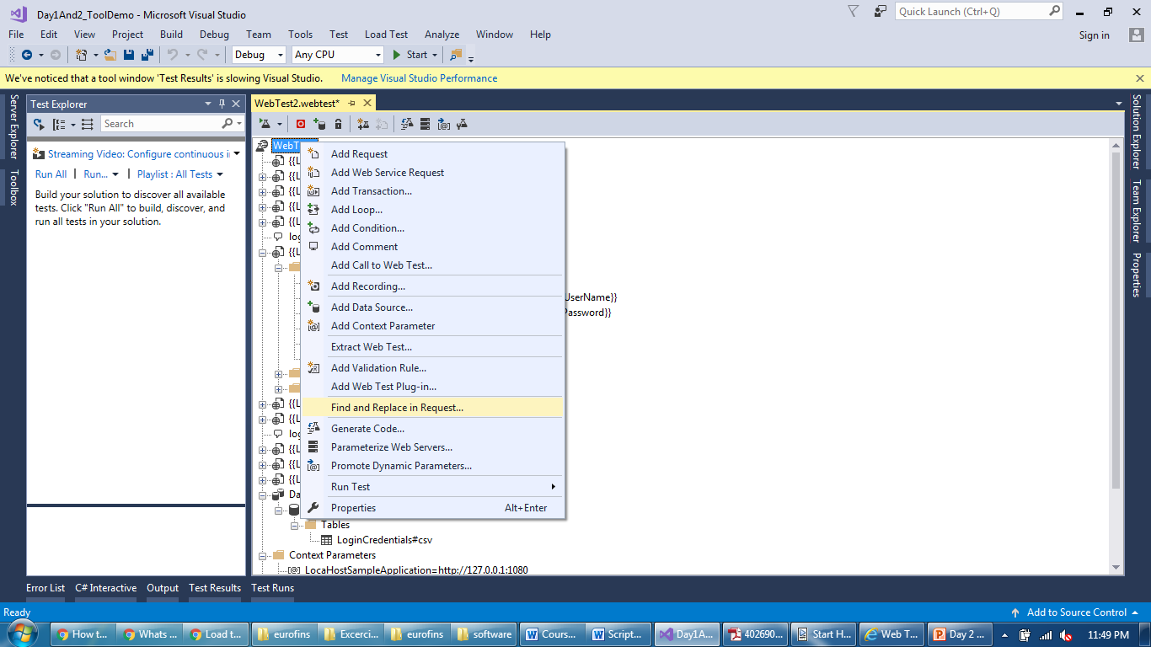
Data Binding
Find and replace all the parameters carefully

Slide 16
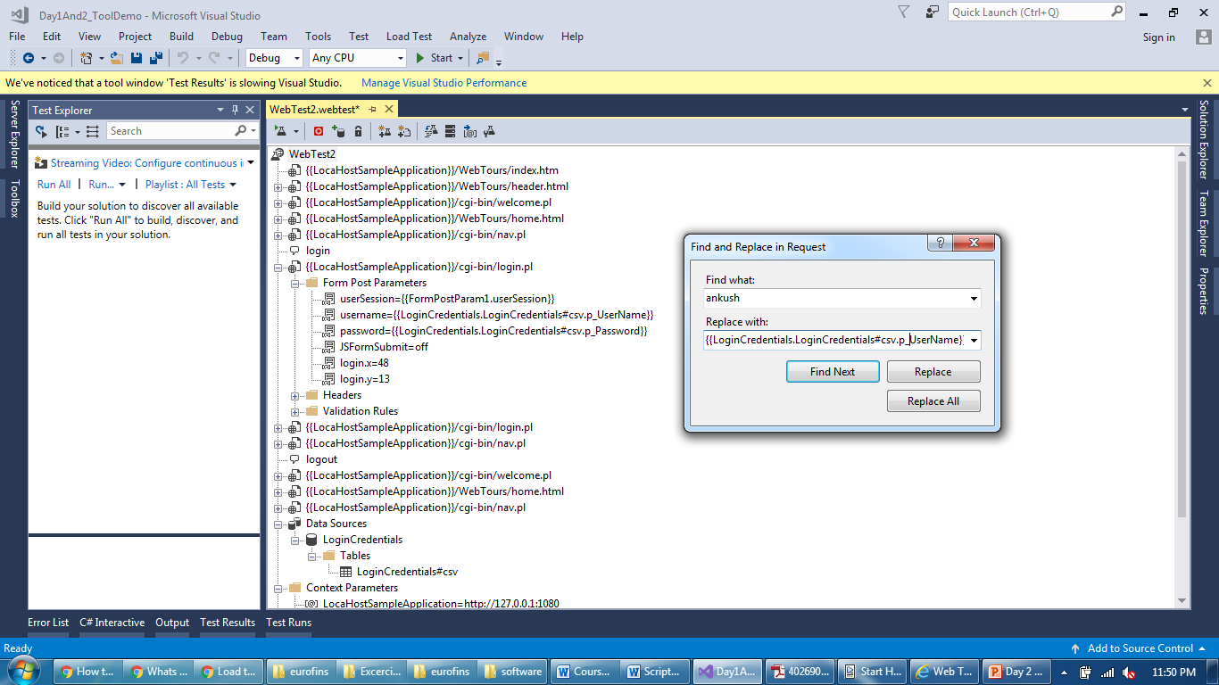
Data Binding
Just like Context Parameter, parameter is surrounded by {{ }}

Slide 17
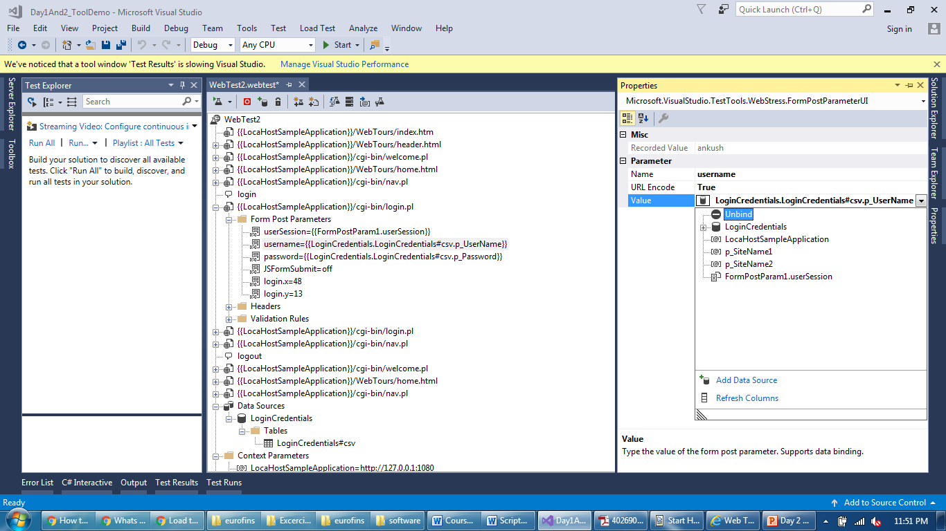
Data Binding
You can also unbind parameter with original value

Slide 18
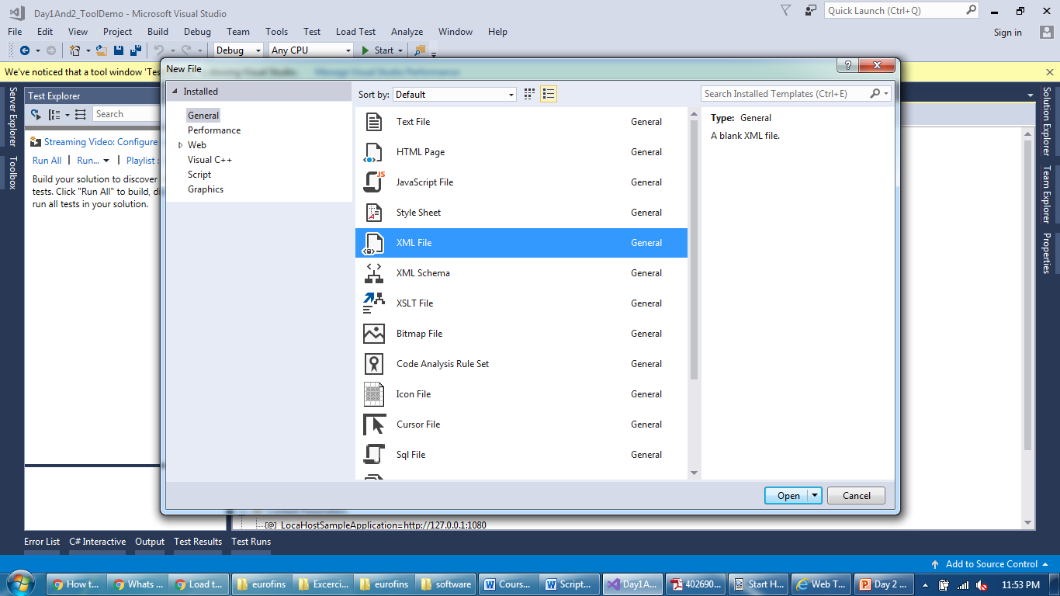
Data Binding
Create a XML file to use as a Data bind file

Slide 19
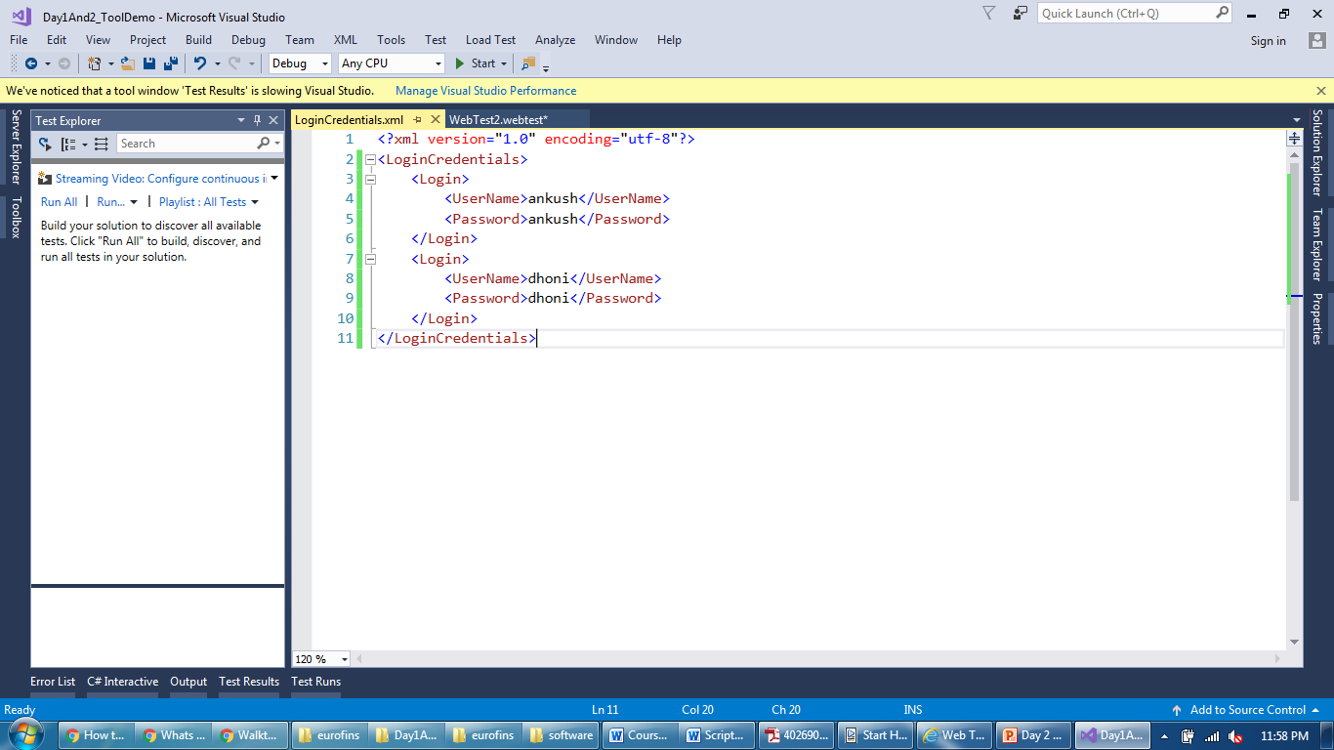
Data Binding
Enter values in enclosed tags

Slide 20
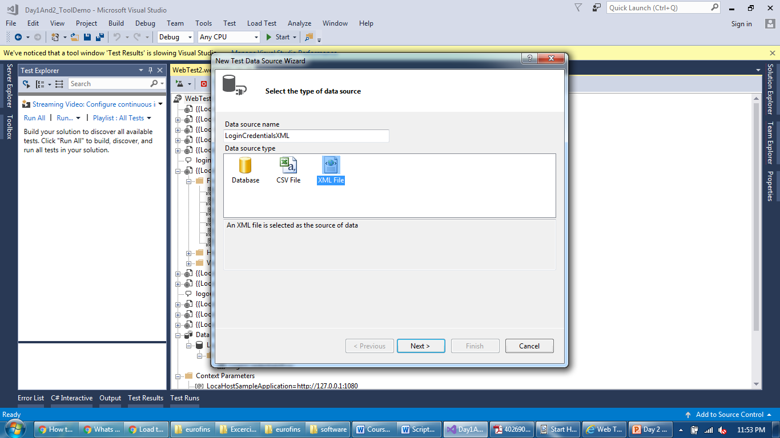
Data Binding
Select XML while adding data source

Slide 21
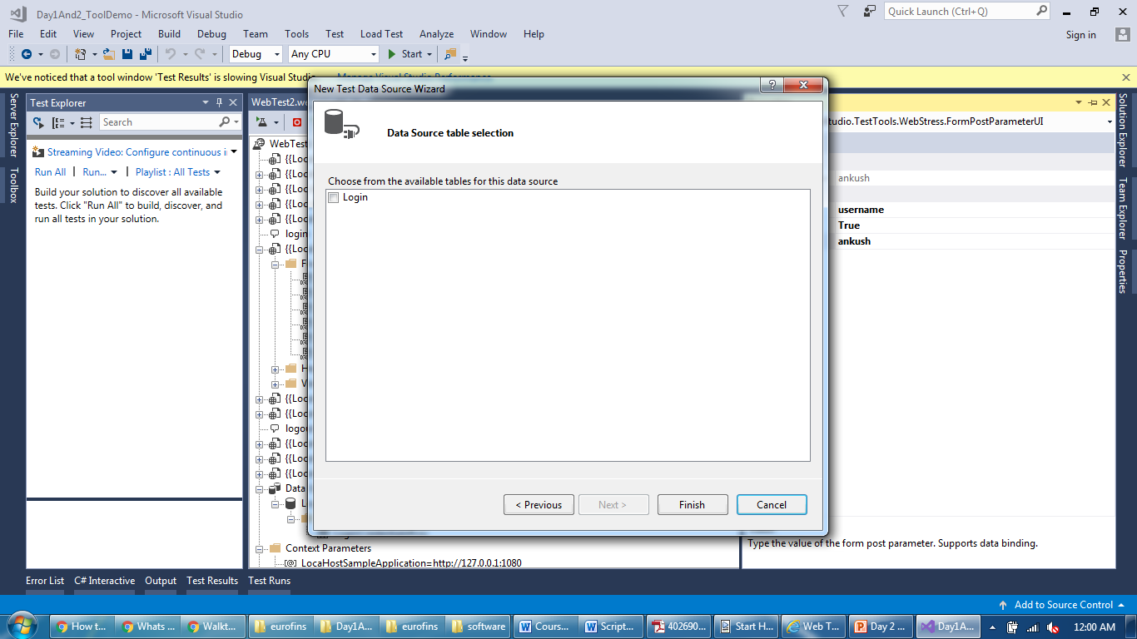
Data Binding
It will ask for table name based upon all parent tags

Slide 22
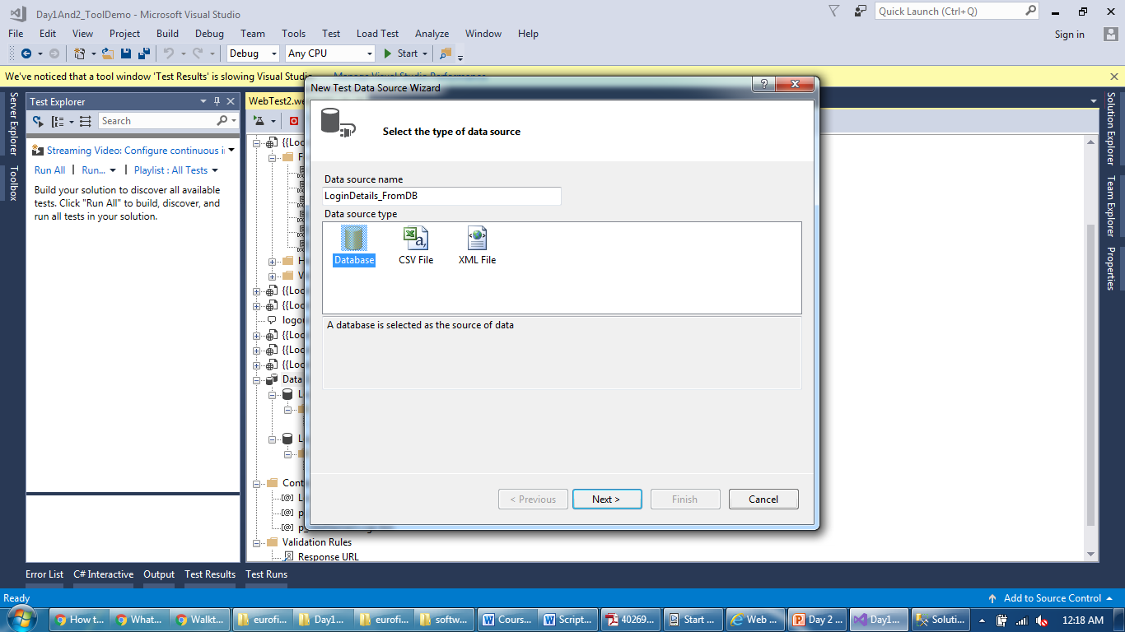
Data Binding
Similarly, you can add any table of the database as DS

Slide 23
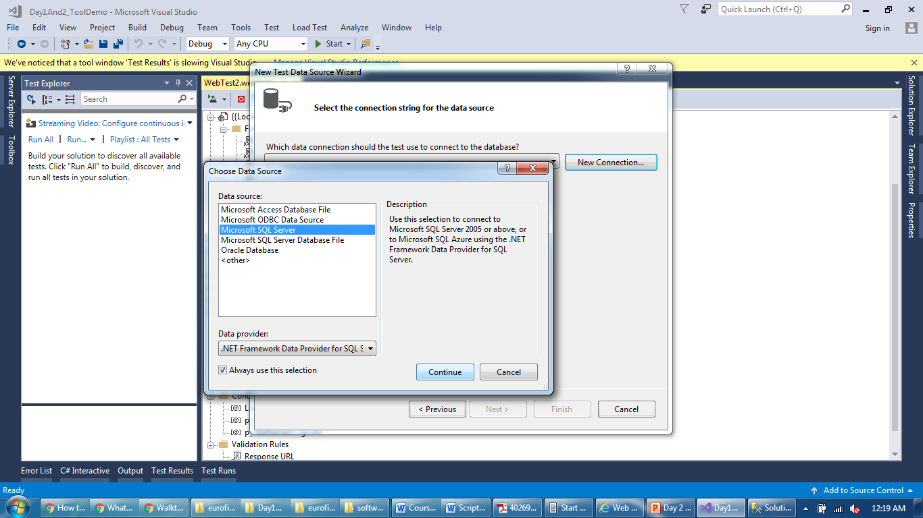
Data Binding
Add connection properties required for a database server

Slide 24
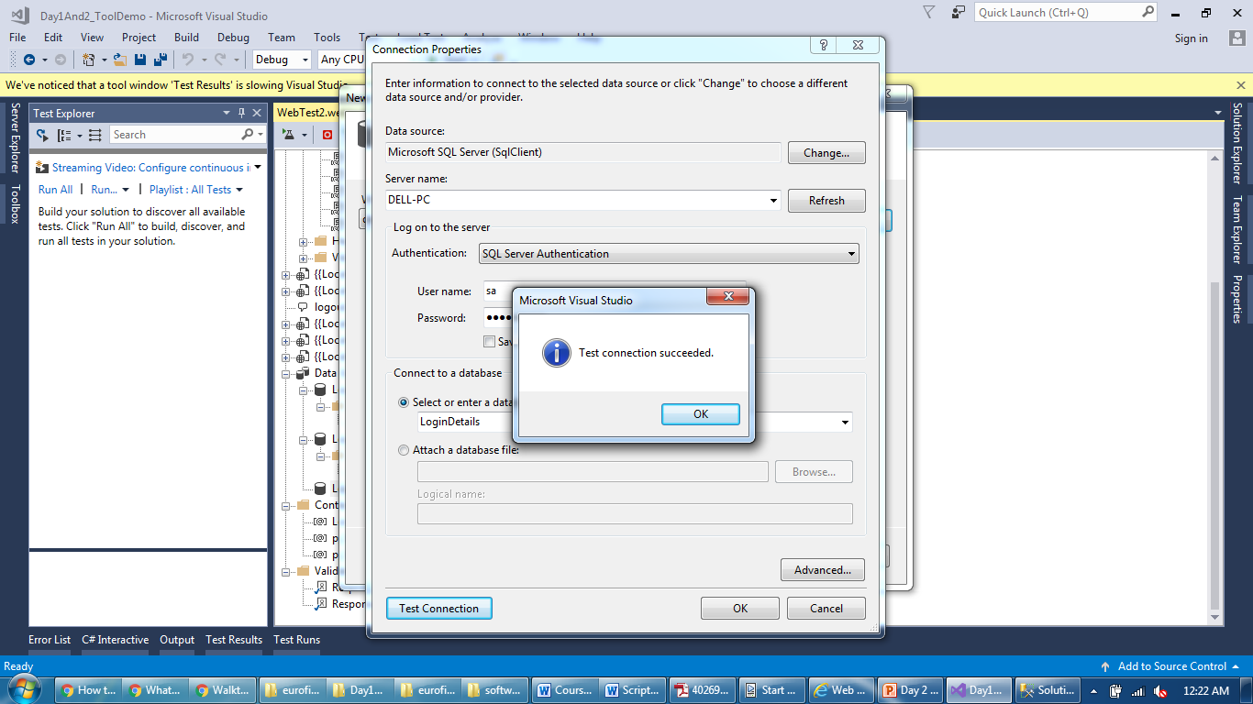
Data Binding
Test the database connection if its successful

Slide 25
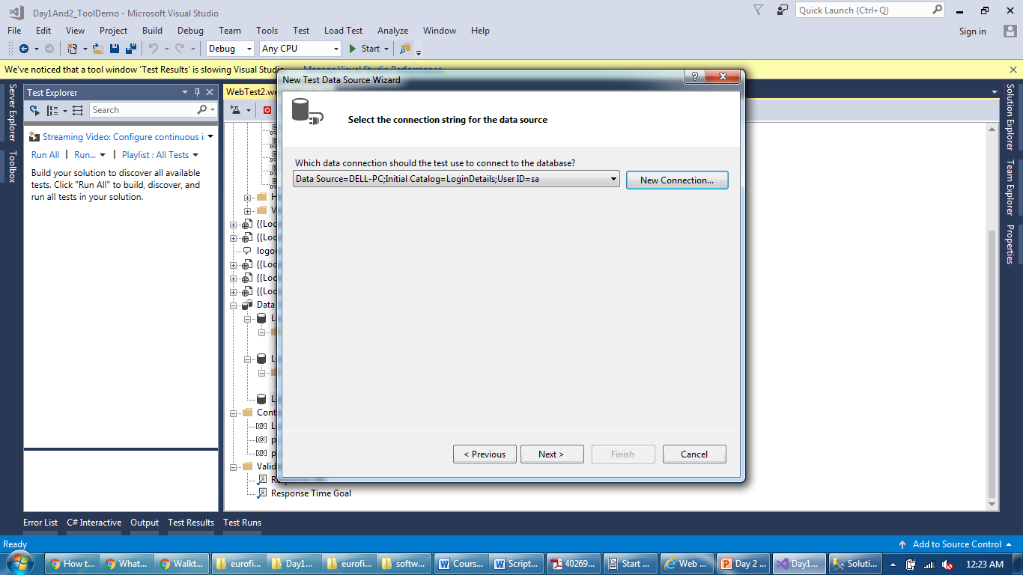
Data Binding
Select connection if more than one

Slide 26
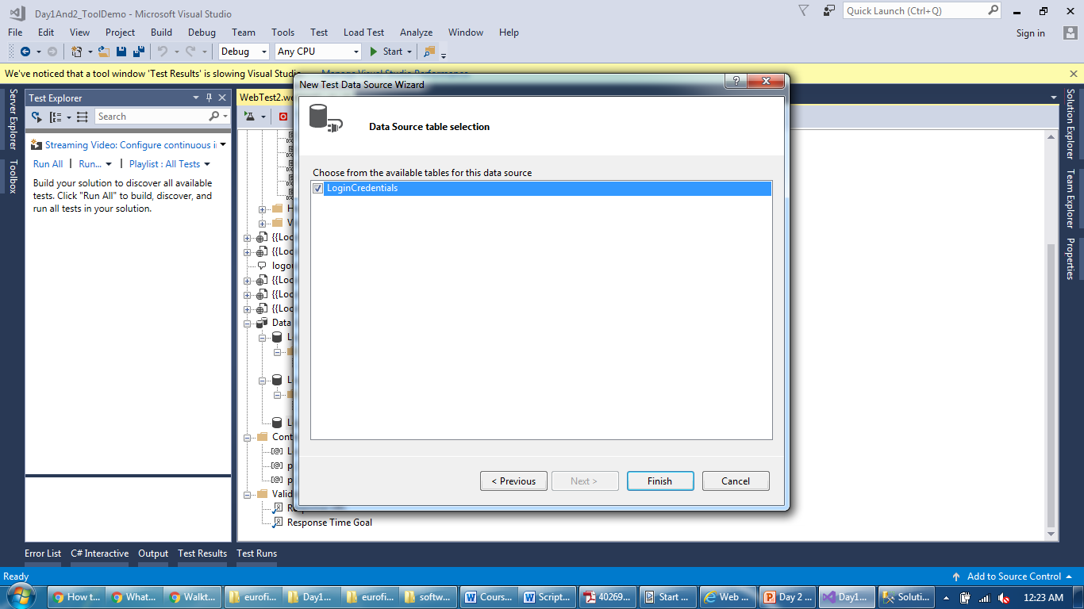
Data Binding
Select table from a database

Slide 27
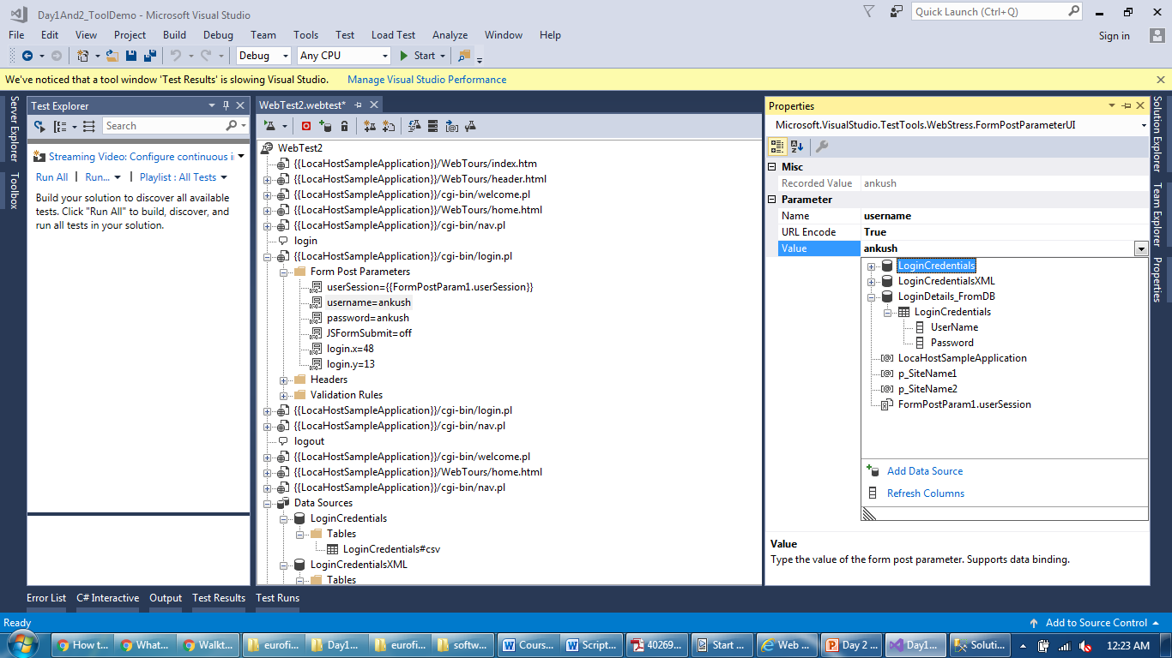
Data Binding
Columns of the table available as a parameter

Slide 28
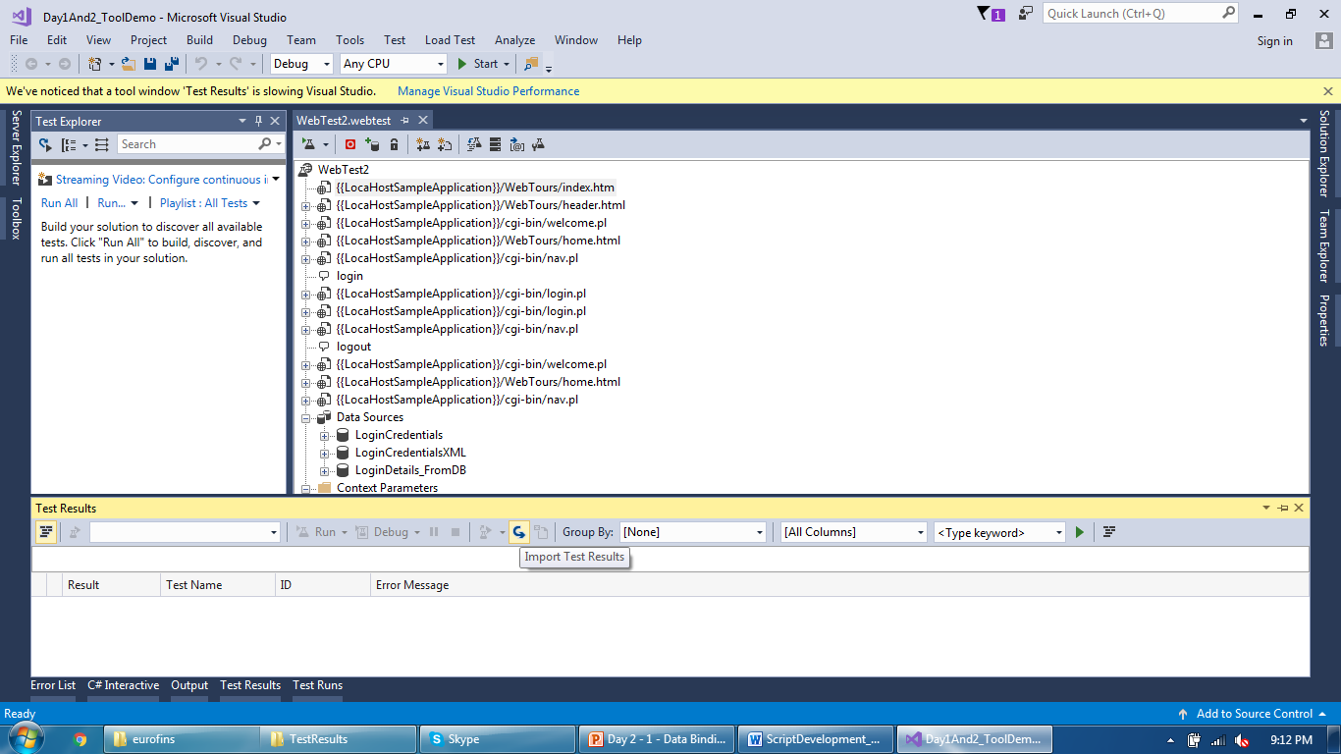
Validation
You can load previously replayed results using following

Slide 29
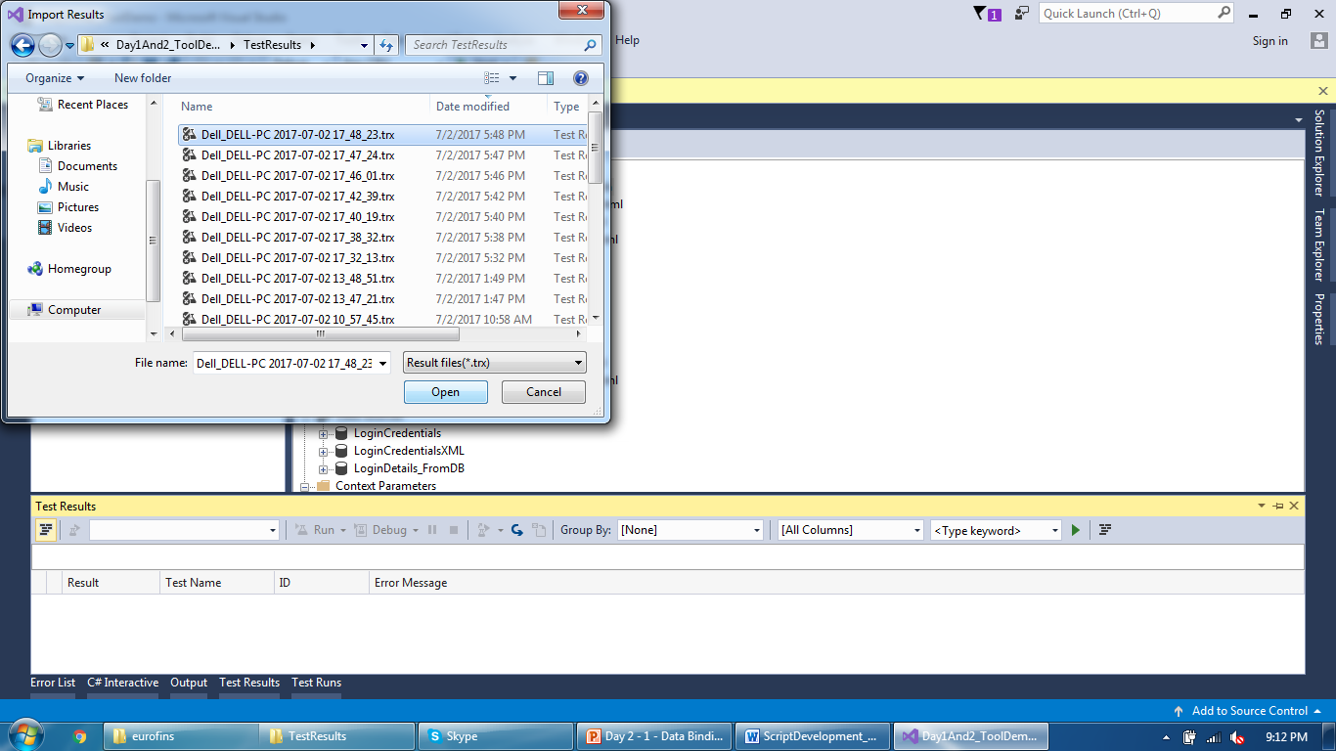
Validation
You can load previously replayed results using following

Slide 30
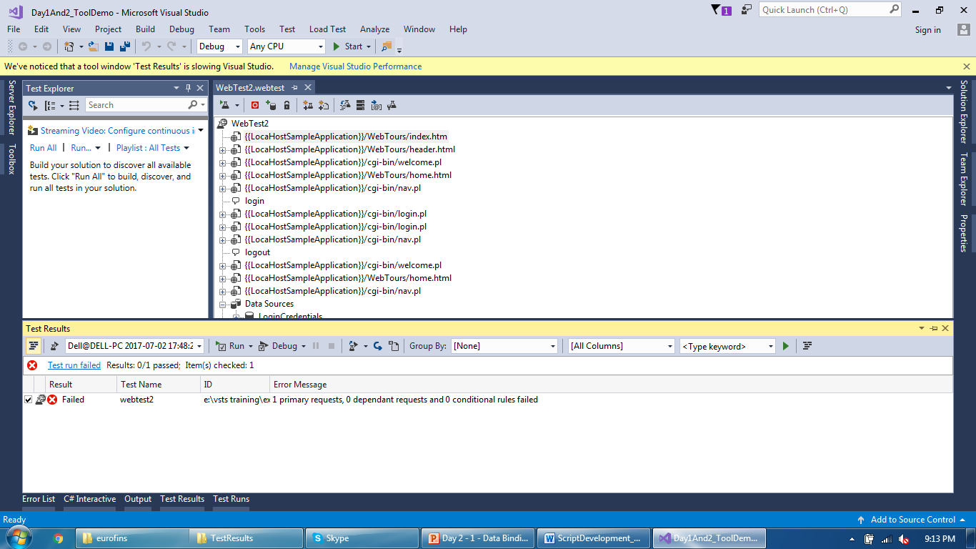
Validation
You can load previously replayed results using following

Slide 31
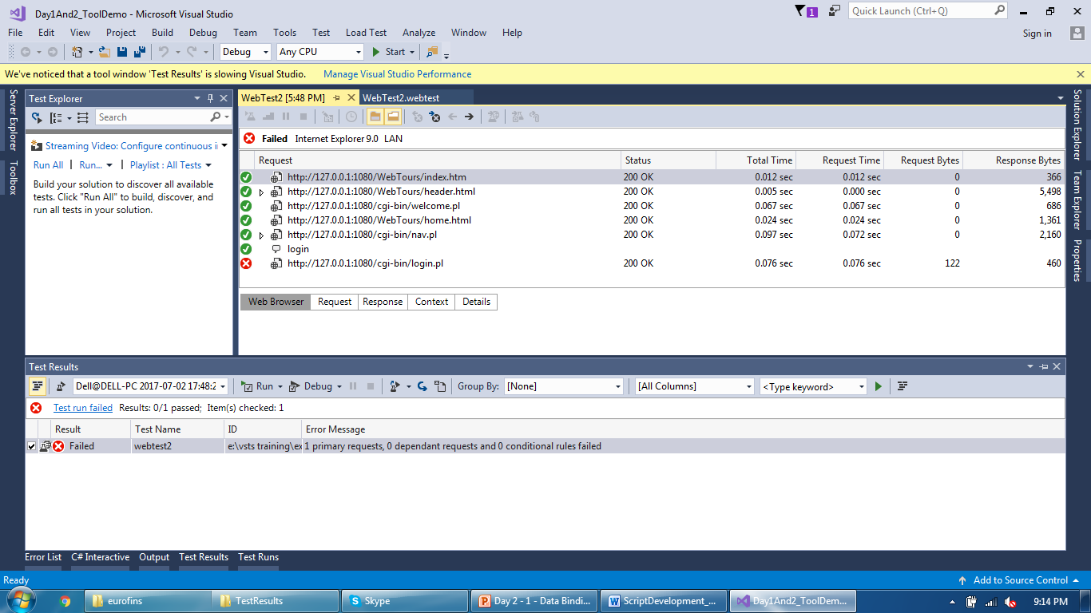
Validation
Double click on results to view detailed results

Slide 32
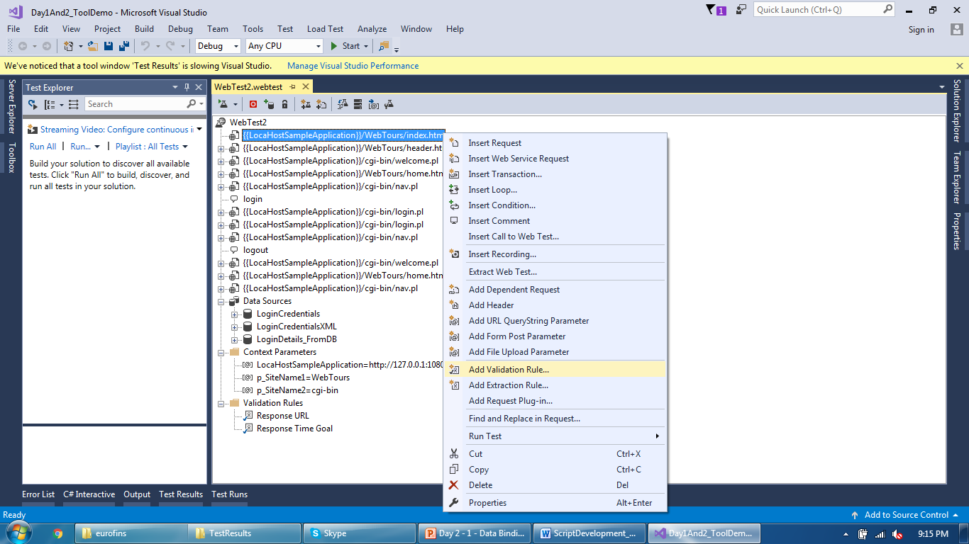
Validation
Select a request and add validation rule

Slide 33
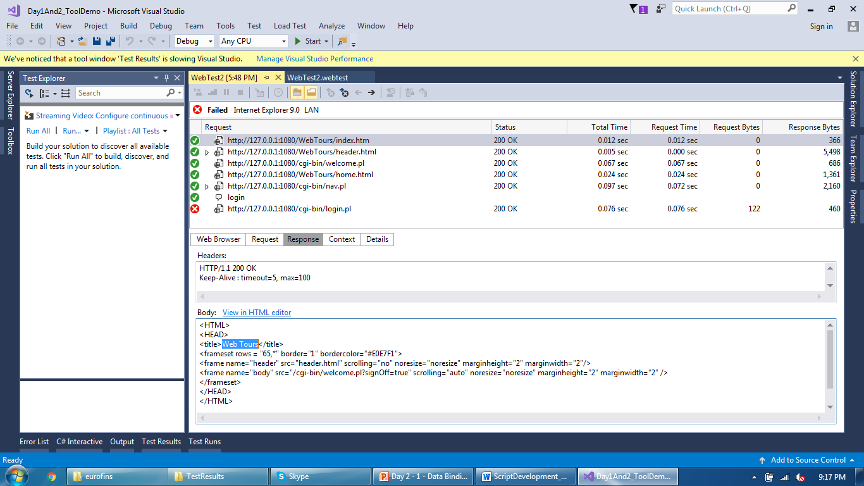
Validation
Identify the text which you want to add as a validation

Slide 34
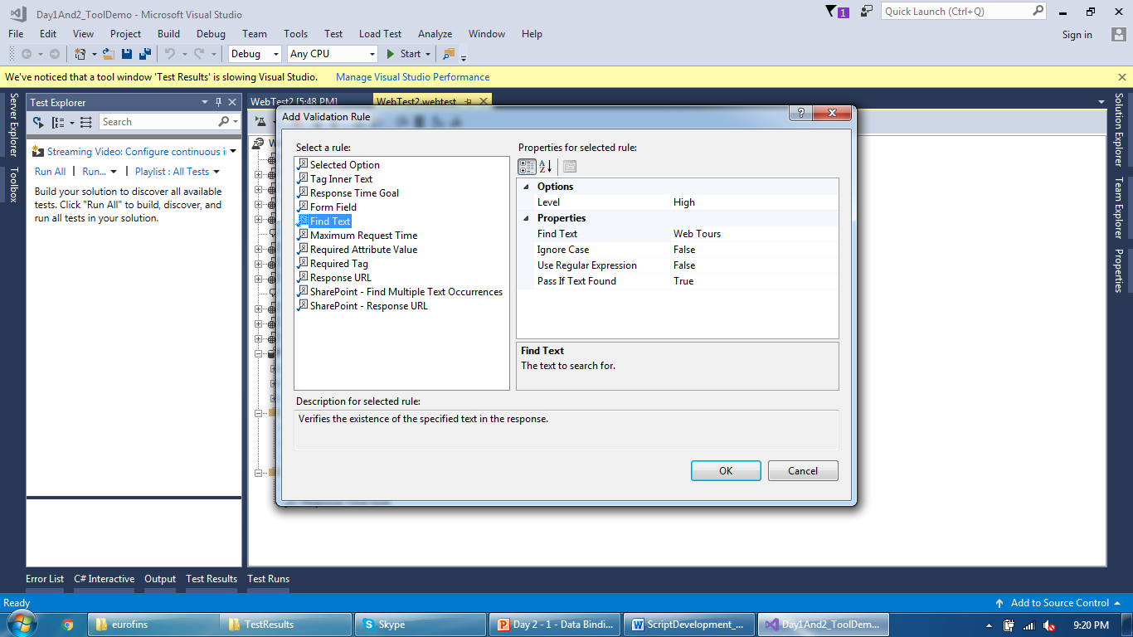
Validation
Exact text needs exact value as input

Slide 35
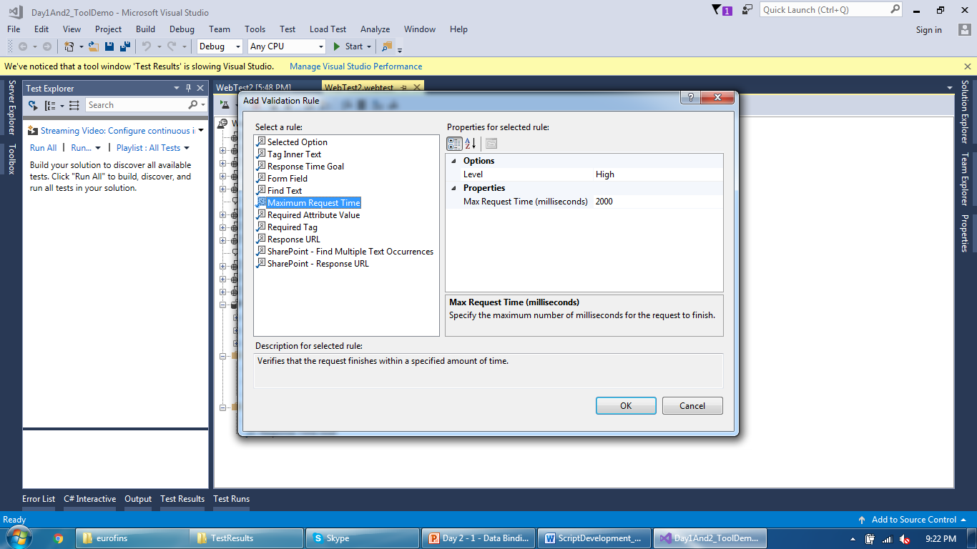
Validation
Request level response time SLA in milliseconds

Slide 36
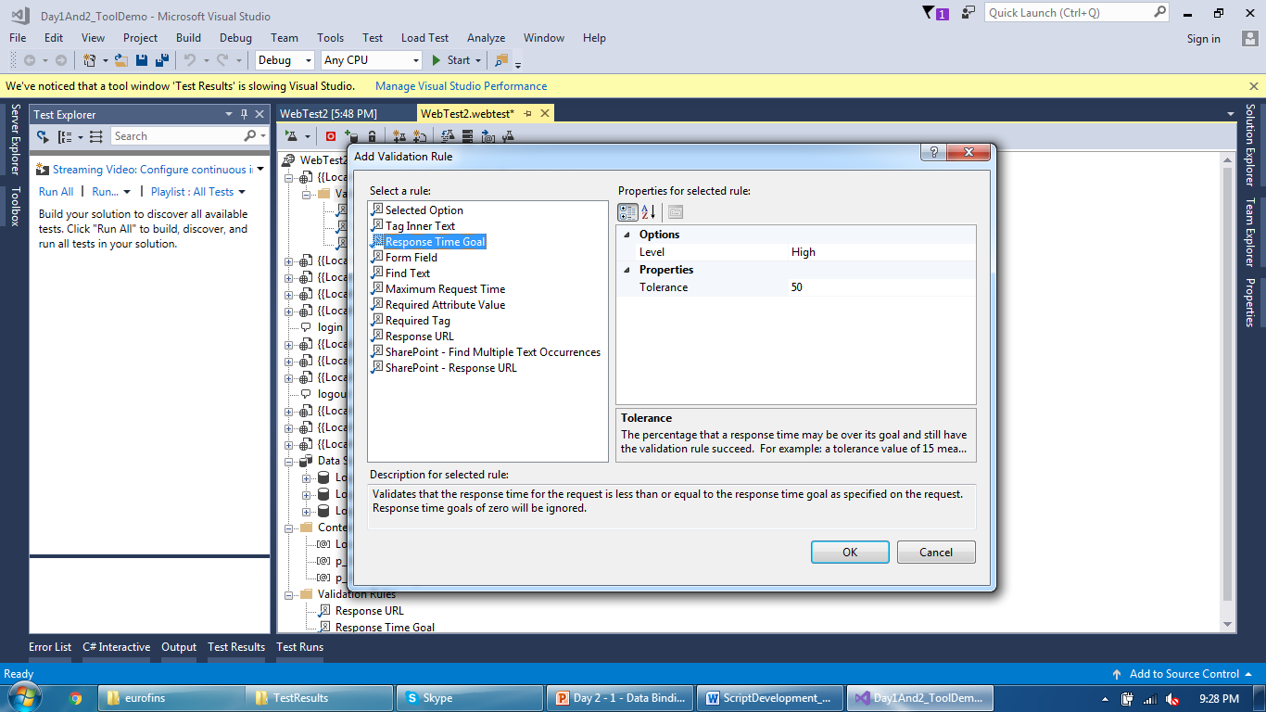
Validation
Deviation in response time goal for a request (in percentage)

Slide 37
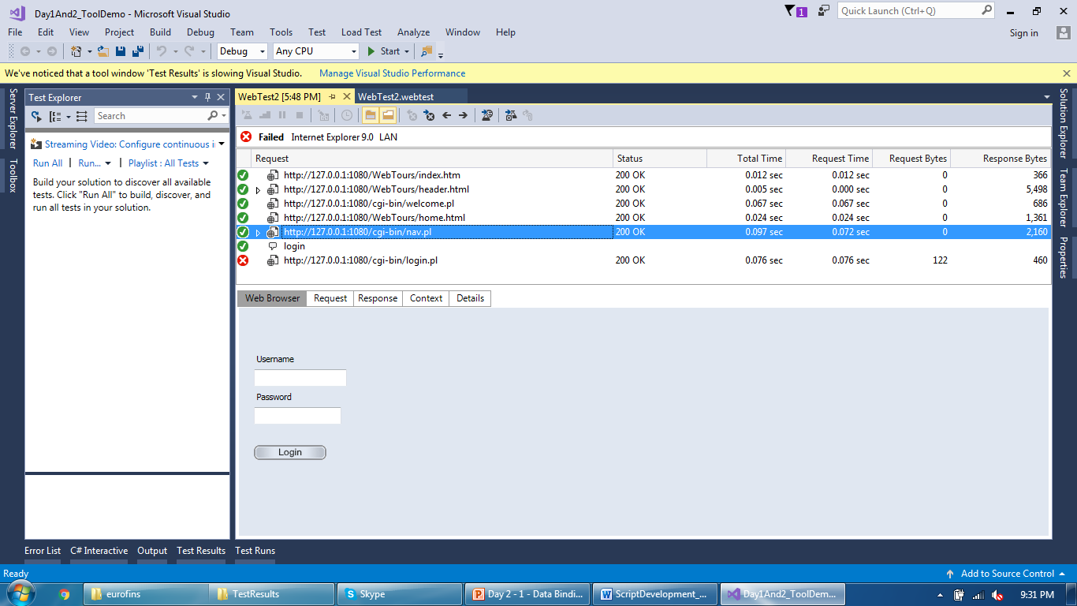
Validation
Identify correct tags or form for validation

Slide 38
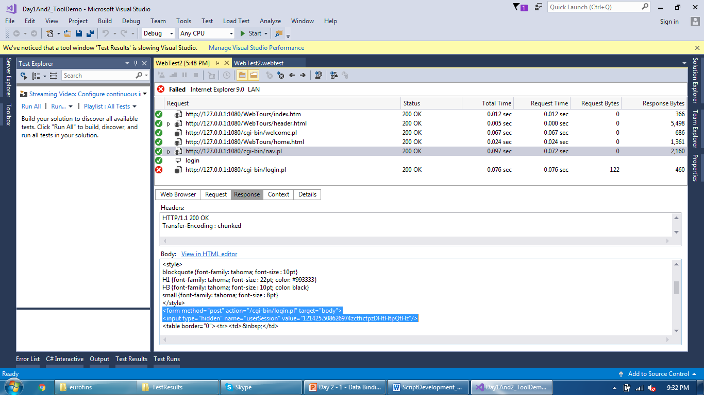
Validation
Tags and Forms available here on this page response

Slide 39
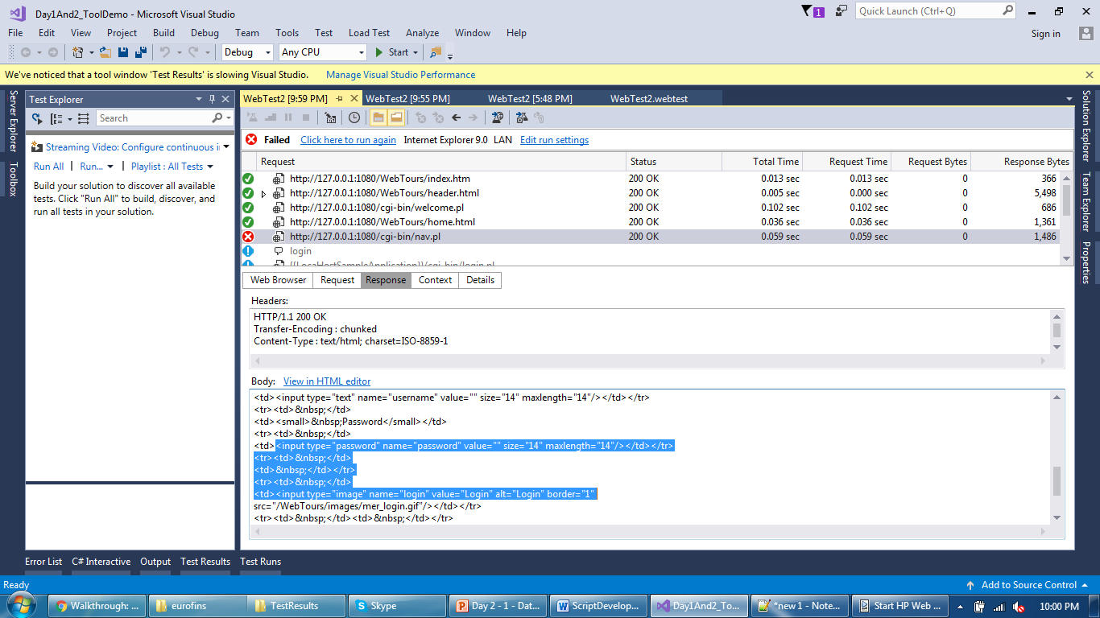
Validation
Tags and Forms available here on this page response

Slide 40
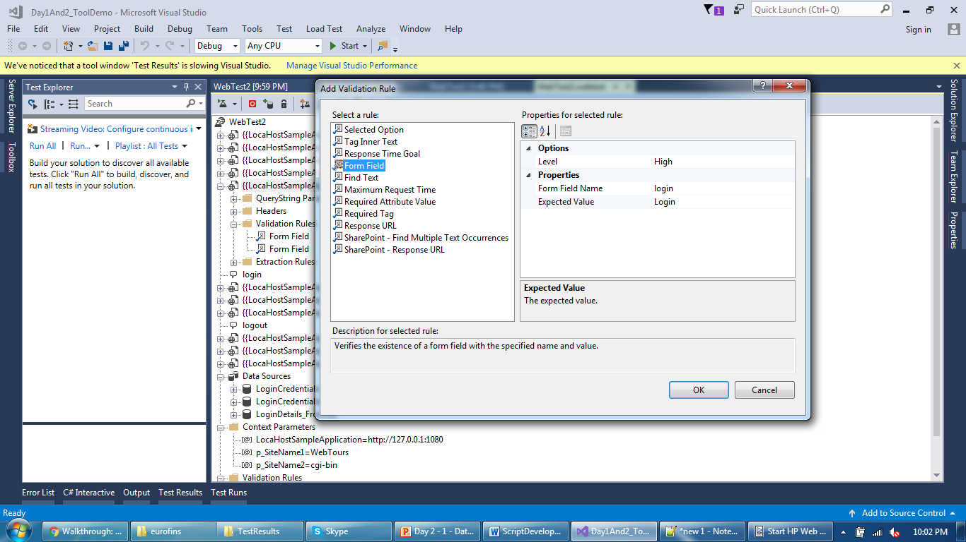
Validation
Added form field name and value which needs to verify

Slide 41
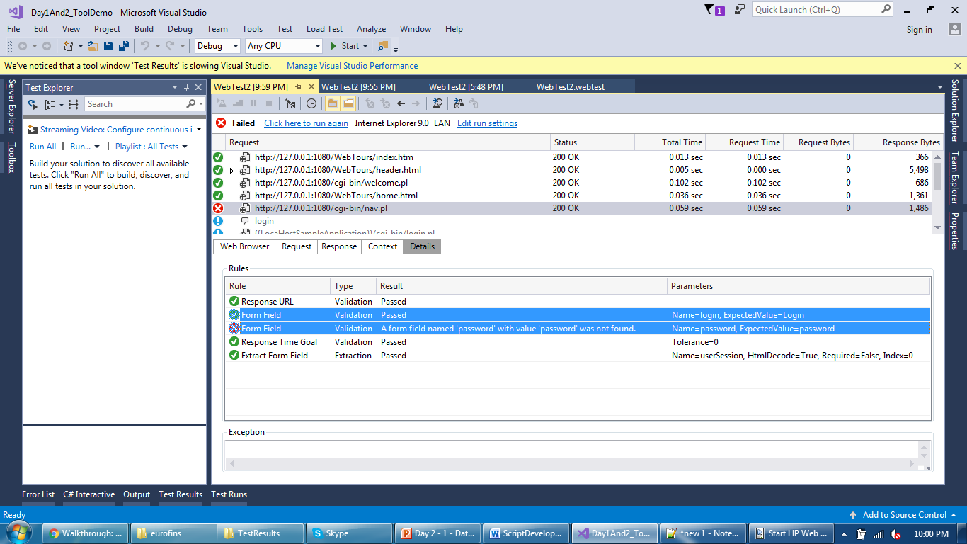
Validation
Intentionally added wrong field value and it failed

Slide 42
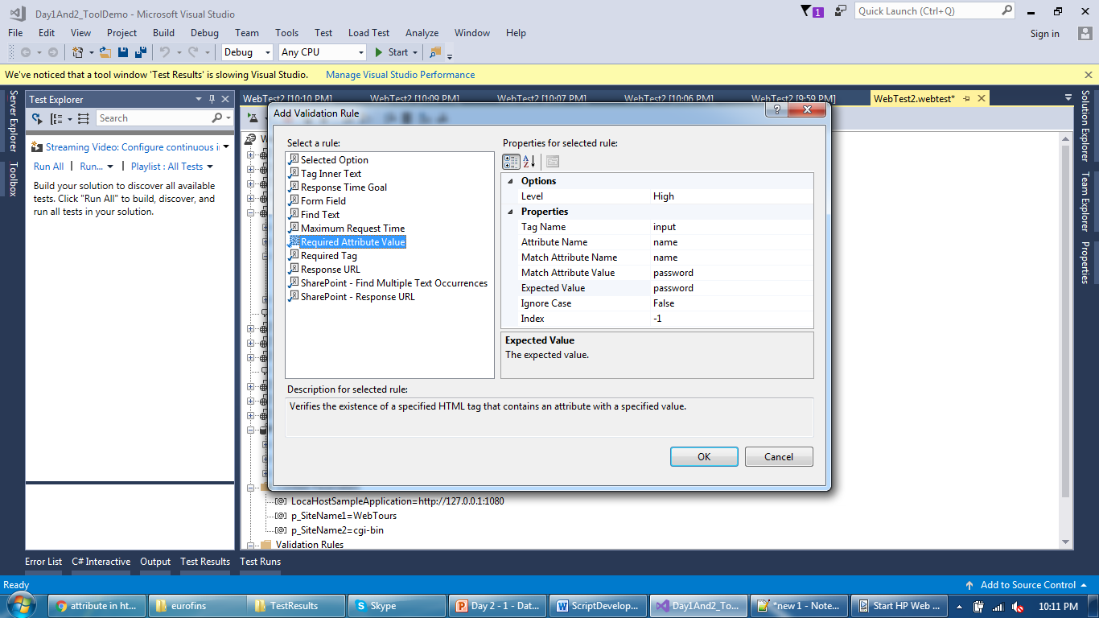
Validation
Validation at the attribute name and value of any tag

Slide 43
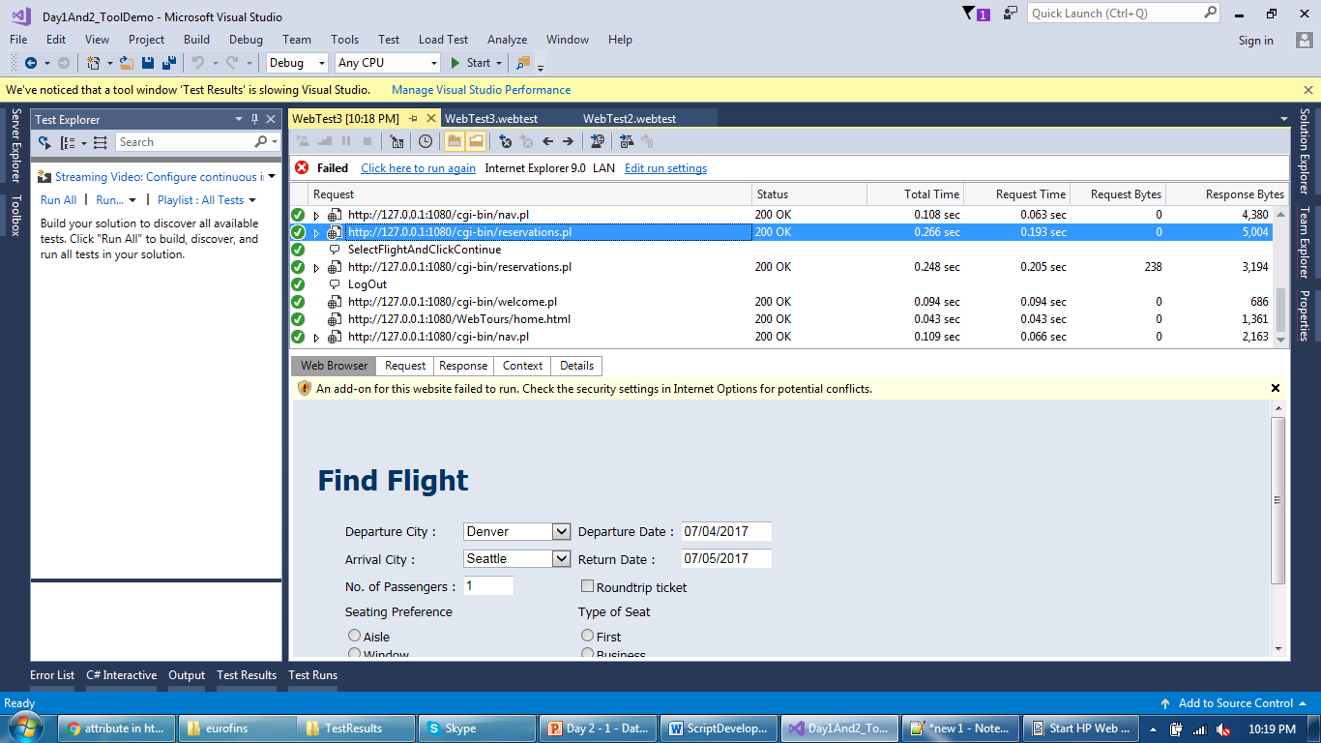
Validation
Identify selected option and inner tags to add their validations

Slide 44
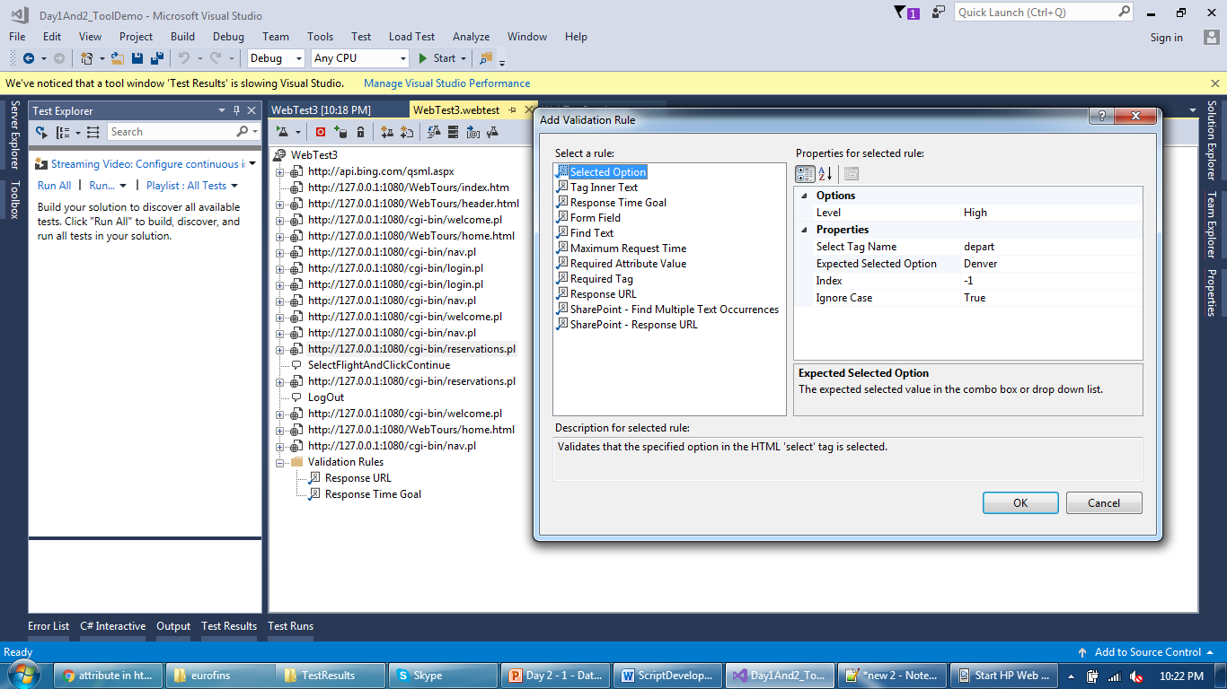
Validation
Default selected option value can be validated like following

Slide 45
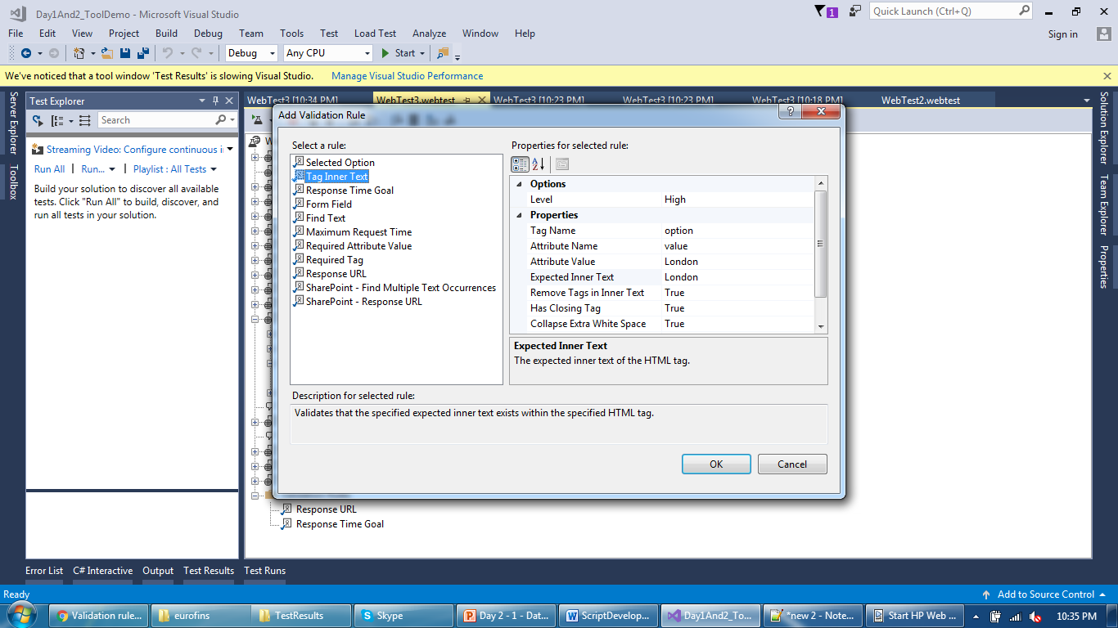
Validation
You can also validate inner text of a tag

Slide 46
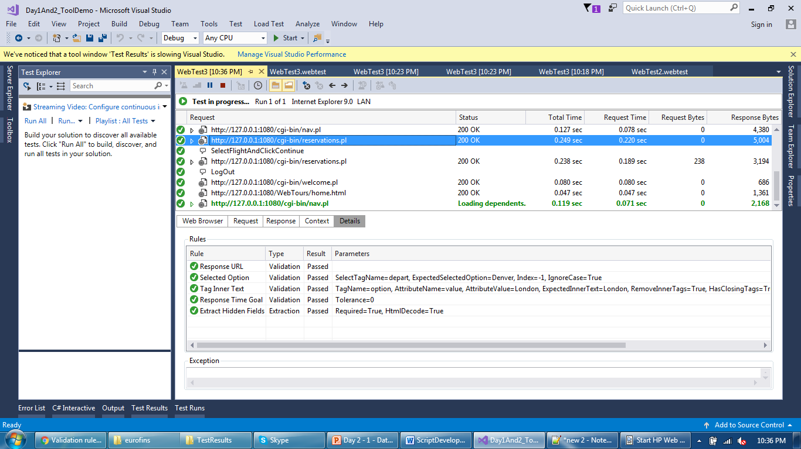
Validation
Verify if validation passed or not in Details tab

Slide 47
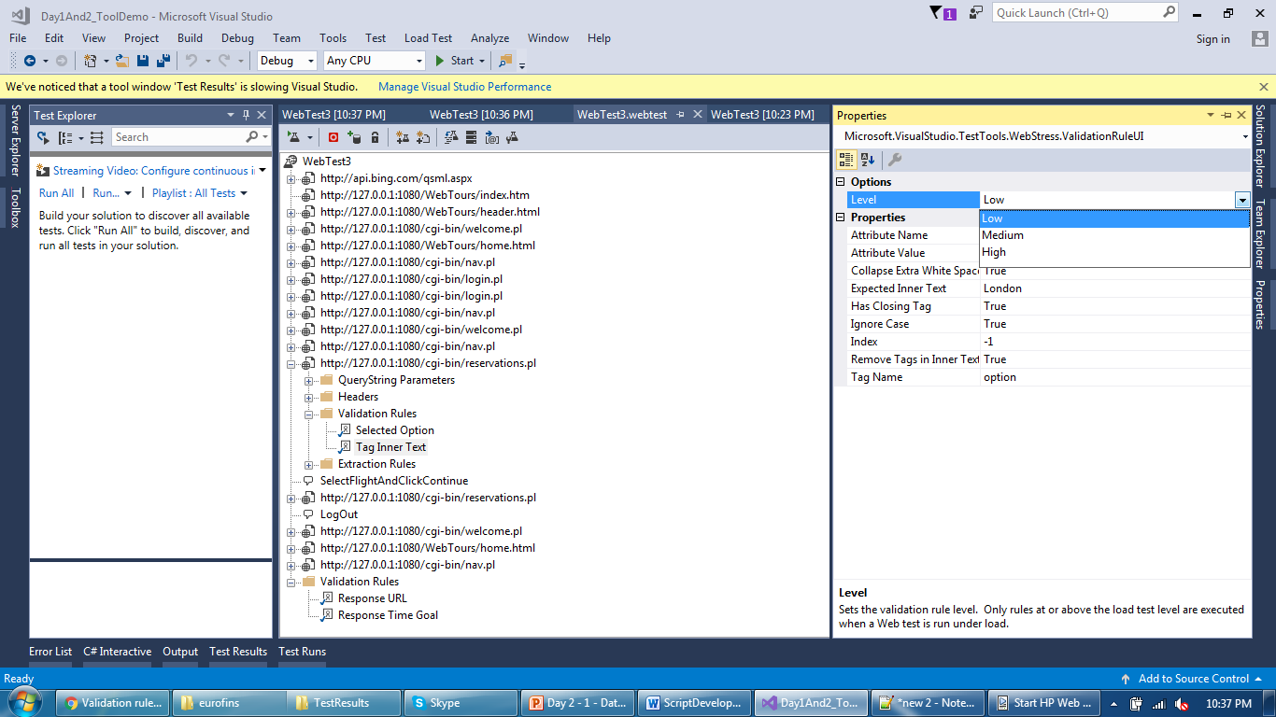
Validation
Validation can be overwritten during Load Test. Invoke validations with Low and Medium if Level if Medium in Load T

Slide 48
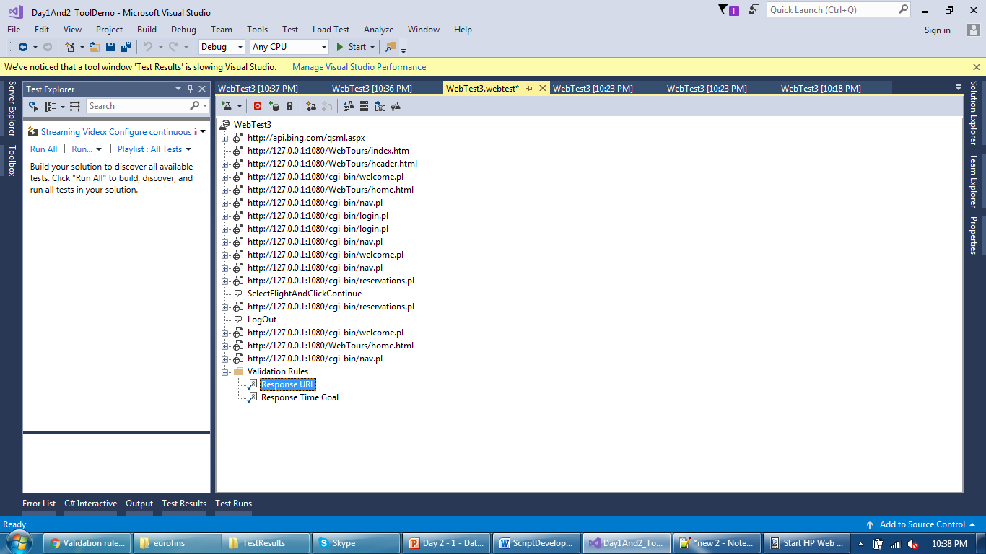
Validation
Validation added at the entire script level

Slide 49
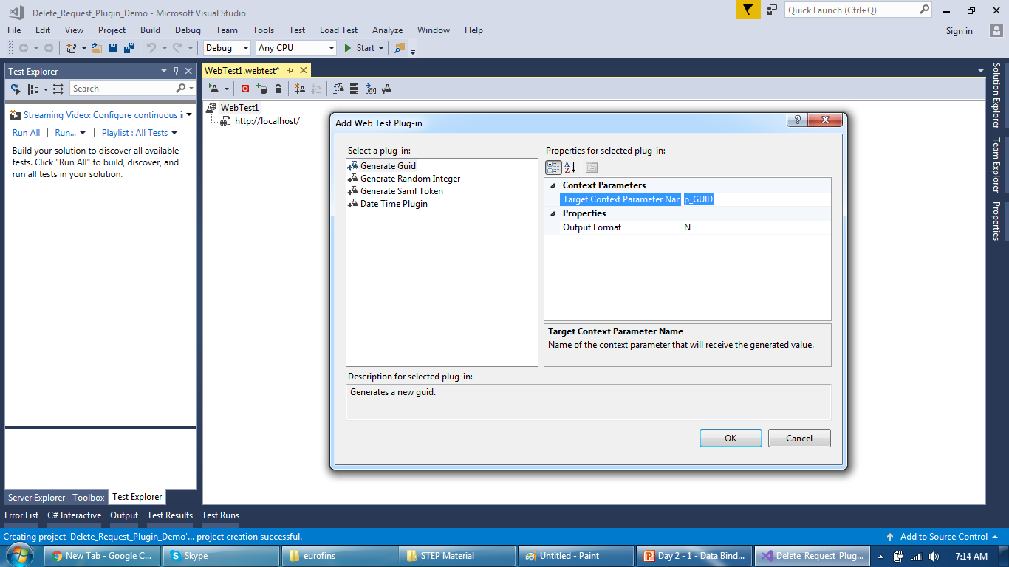
Tool Overview
Request Plugin - GUID

Slide 50
Tool Overview
Request Plugin - GUID

Slide 51
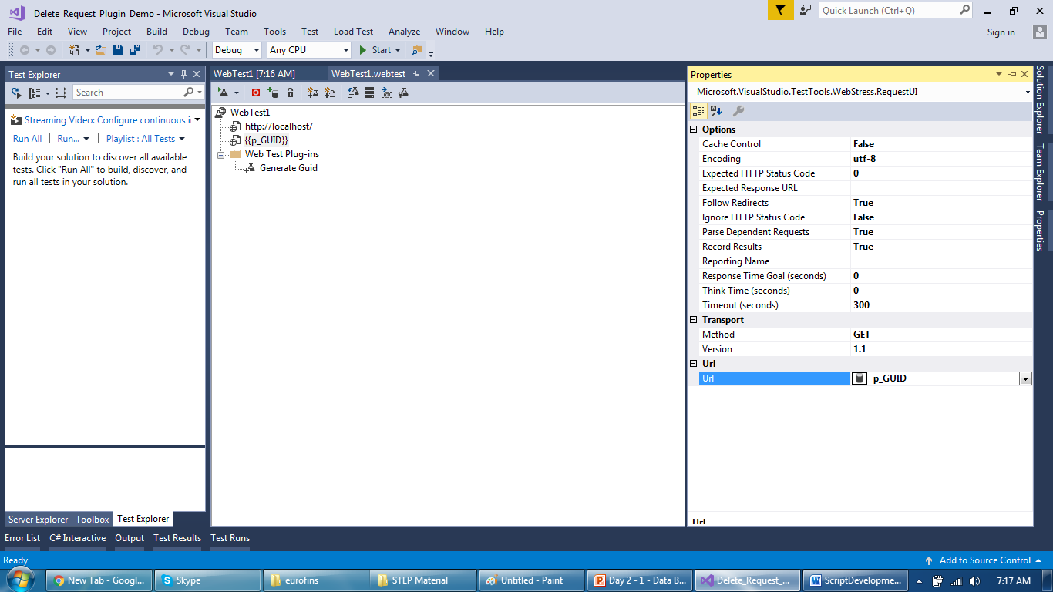
Tool Overview
Replace value with a parameter enclosed in {{ }}

Slide 52
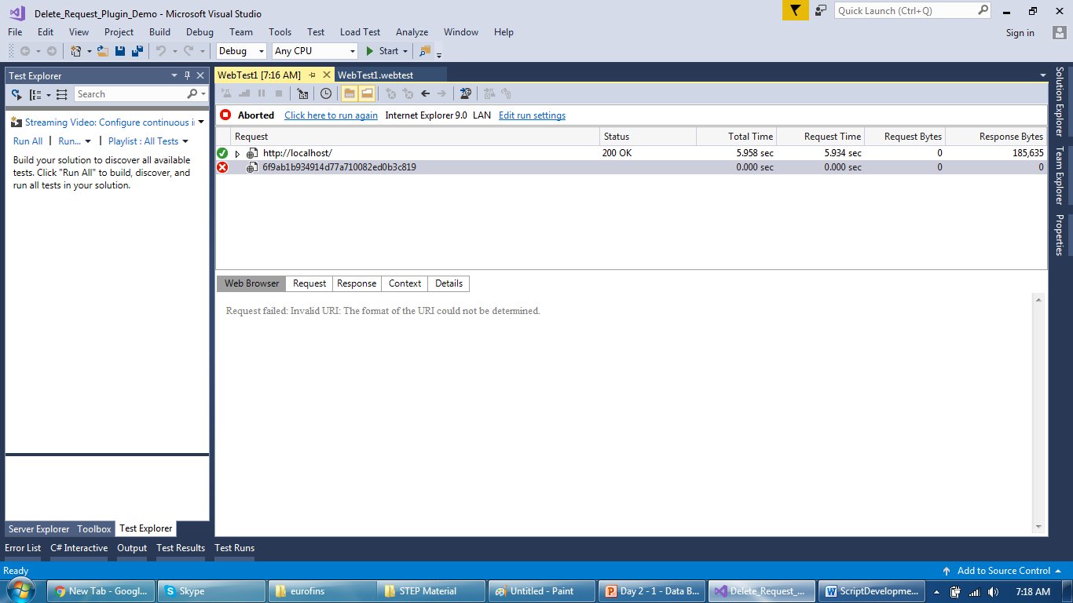
Tool Overview
During script run, parameter is replaced by a value

Slide 53
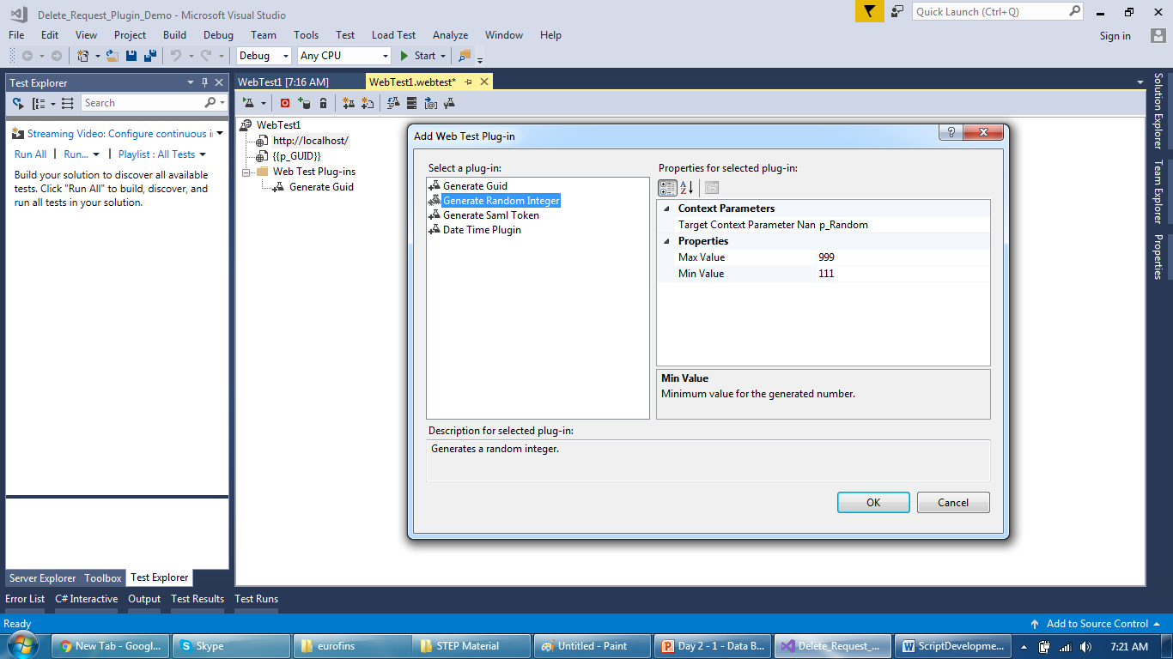
Tool Overview
Parameter created with Random number type

Slide 54
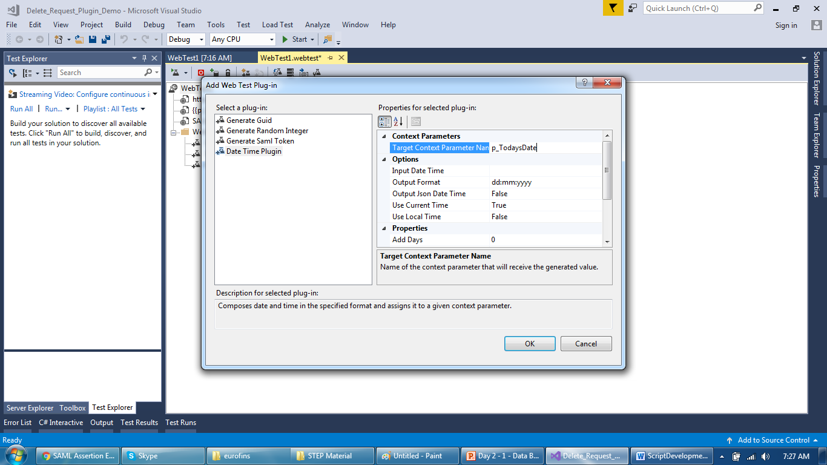
Tool Overview
Context parameter at request level for Date time type

Slide 55
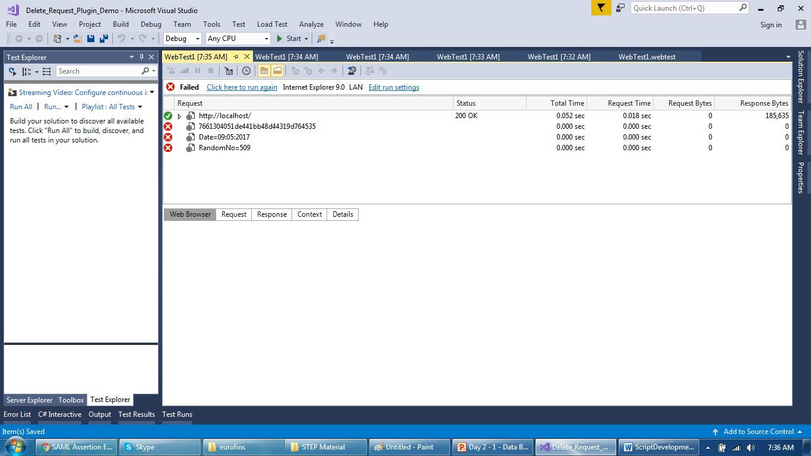
Tool Overview
Context Parameter values replaced during run time

Slide 56

Tool Overview
One more type of Context Parameter

Slide 57

Tool Overview
Use Regular Expression turned to True

Slide 58

Tool Overview
Value replaced at run time

Slide 59
Thank You

